Slide 1

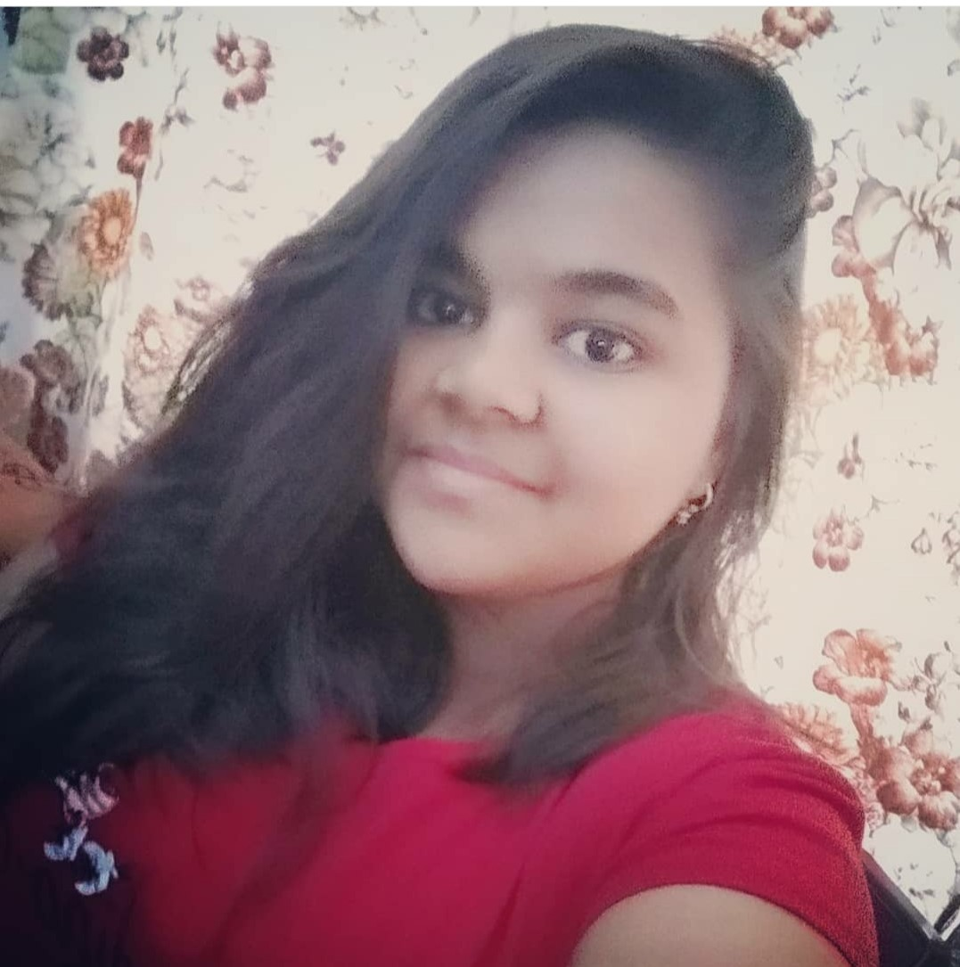

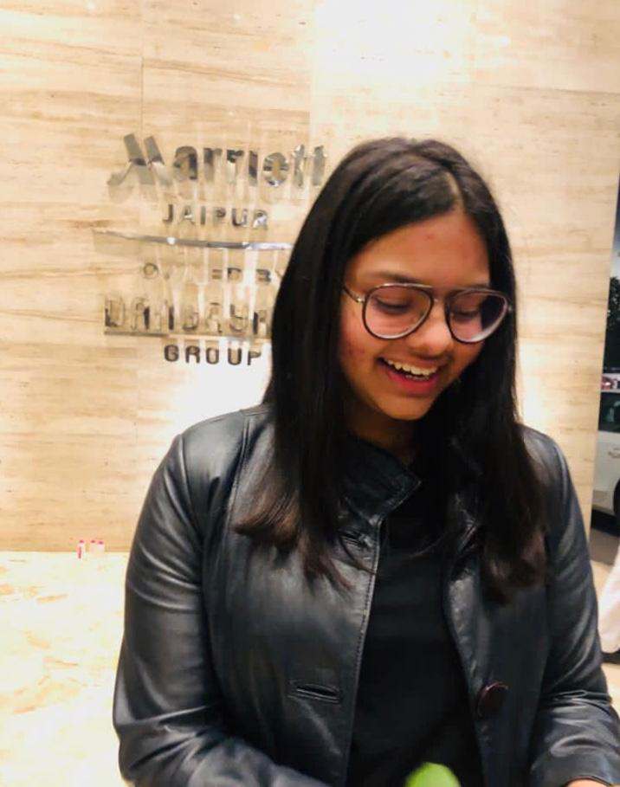
TEAM ADYANT
A
Aakriti
(Fresher B-tech CSE)
Kirti Singh (Fresher
B-tech CSE)
Jheel Soni
(Fresher
B-tech CSE)
Ananya Sharma
(Fresher B-tech CSE)

Slide 2
PROBLEMS
Staying Up-To-Date With Modern Tech
Designing e-learning Courses For Different Generations
Lack Of Learner Motivation And Engagement
Measurable learning outcomes
Education
Adaptive learner models to accommodate different learner needs
Transforming learning into Amazing e-learning Experiences

Slide 3
WHY WE CHOSE THIS TOPIC?
In this period of the pandemic, many sectors suffered but the most affected sector was education and no one of us can deny the fact that it is the most important pillar of our society and the online culture of education is not that much engaging for students of all age group, so our team came up with the idea of creating an open-source website and the main reason that we didn't opt for an app is that we are targeting masses and website is easily accessible in comparison of apps.

Slide 4
SOLUTION
So here we bring the solution to all six problems, an open source quiz website by us. As we all know the engagement is very low in online learning, so what if we introduce the culture of giving quizzes. So basically our motto is "Putting learners in the driving seat is a great way of increasing their engagement with a digital learning experience.“

Slide 5
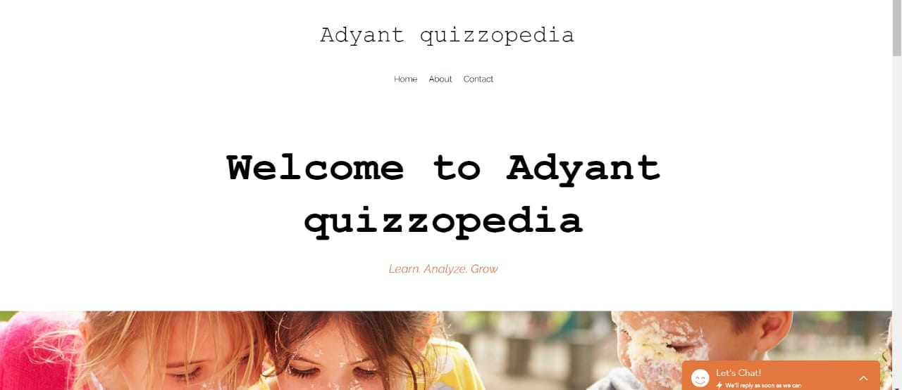

Slide 6
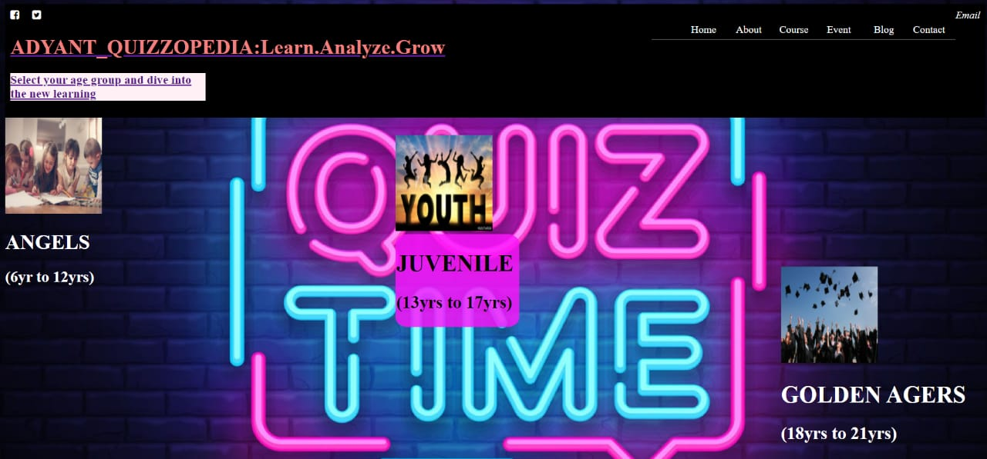
SO HERE IS THE GLIMPSE OF OUR WEBSITE

Slide 7
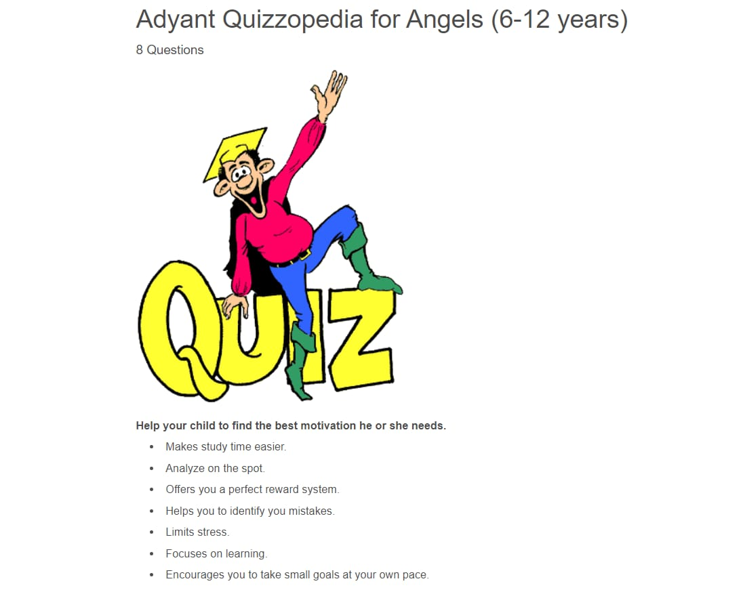


We have kept in mind three age groups while creating the quiz
1.Angels (6-12 years)
We will be covering general knowledge questions which will make kids eager to read more about these things. Now a days kids, enjoy learning while playing. Keeping this in mind we made a quiz for them to learn with fun.

Slide 8


2. JUVENILE (13-17 YEARS)
We have created this quiz with the motto of testing observation skills of this age group, it consists of question related to things which we see around us on daily basis. Students receive so much more than an ordinary education through our quizzes.

Slide 9


3. GOLDEN AGERS (18-21 YEARS)
In this quiz, we would be covering the real-life problems which would be solved using experience and academic knowledge. Our main motto for creating a quiz for golden agers is to make them analyze their knowledge and share their real life experiences.

Slide 10


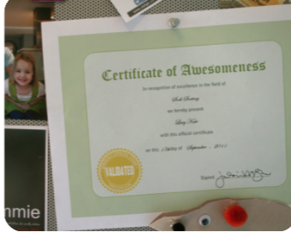
HOW CAN WE INCREASE ENGAGEMENT ?
We will be giving some certificates at the end of quiz and even planning to introduce some interesting badges in our quizzes.

Slide 11
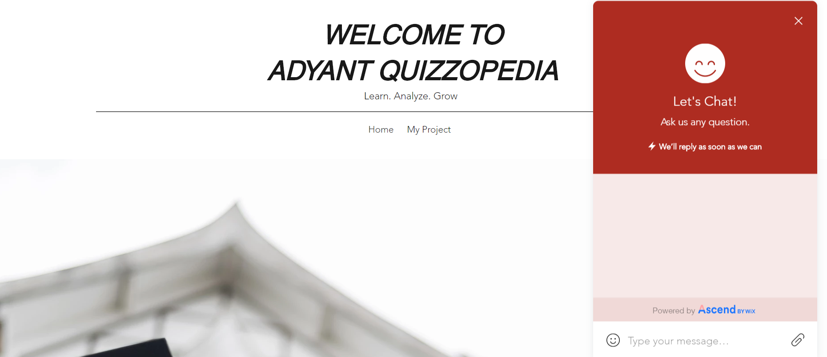
•We even created a chatbot for users convenience here is a glimpse of it.

Slide 12
WE ARE EVEN THINKING TO WORK ON…
We plan to add tools that are going to crush the process of submitting the assignments and the projects just a click away. What we want to offer the students is the availability of tools/resources like, 3-D calculators, GNU octave, NumPy, etc in our interface so that students will no more have to follow that long procedure of making diagrams, graphs, 3-D graphs, automata, tree diagrams on paper then scanning and converting it to pdfs and then uploading it to the respective teachers instead can directly do the assignments on our interface and then submitting.

Slide 13

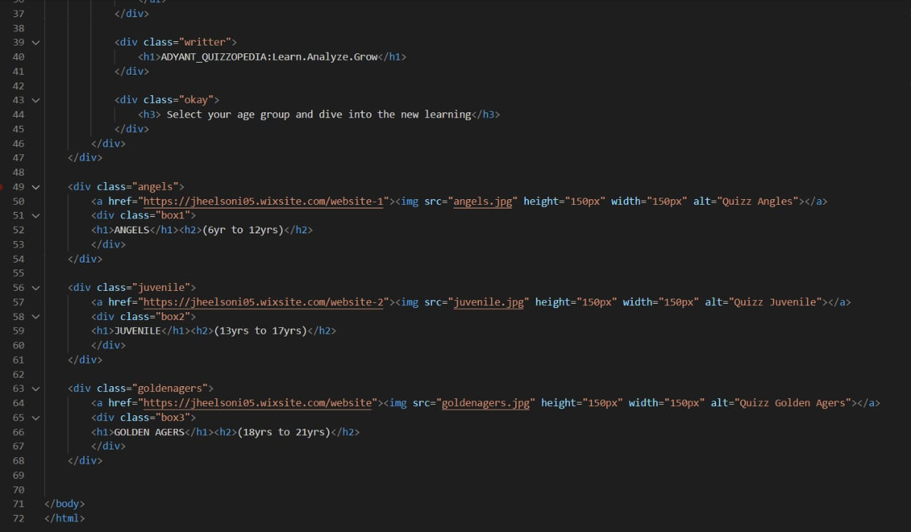


SO HERE IS THE GLIMPSE OF OUR WEBSITE

Slide 14
ANY QUESTIONS ?

Slide 15
THANK YOU

